Slide 1
Unreal Engine Game

Slide 2
Game description:
1st person 3d open world game built in Unreal Engine 4
What is Unreal Engine 4?

Slide 3
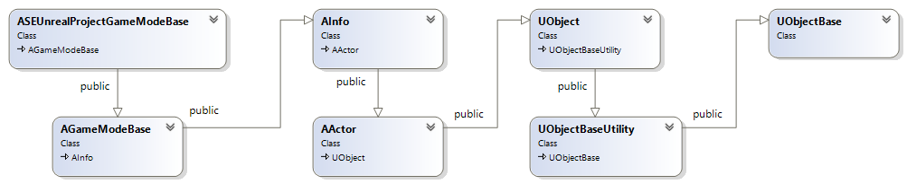
Talk is cheap show me the diagrams: Class diagram:

Slide 4
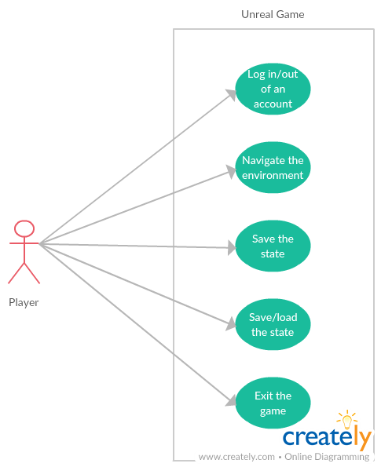
Use case diagram:

Slide 5
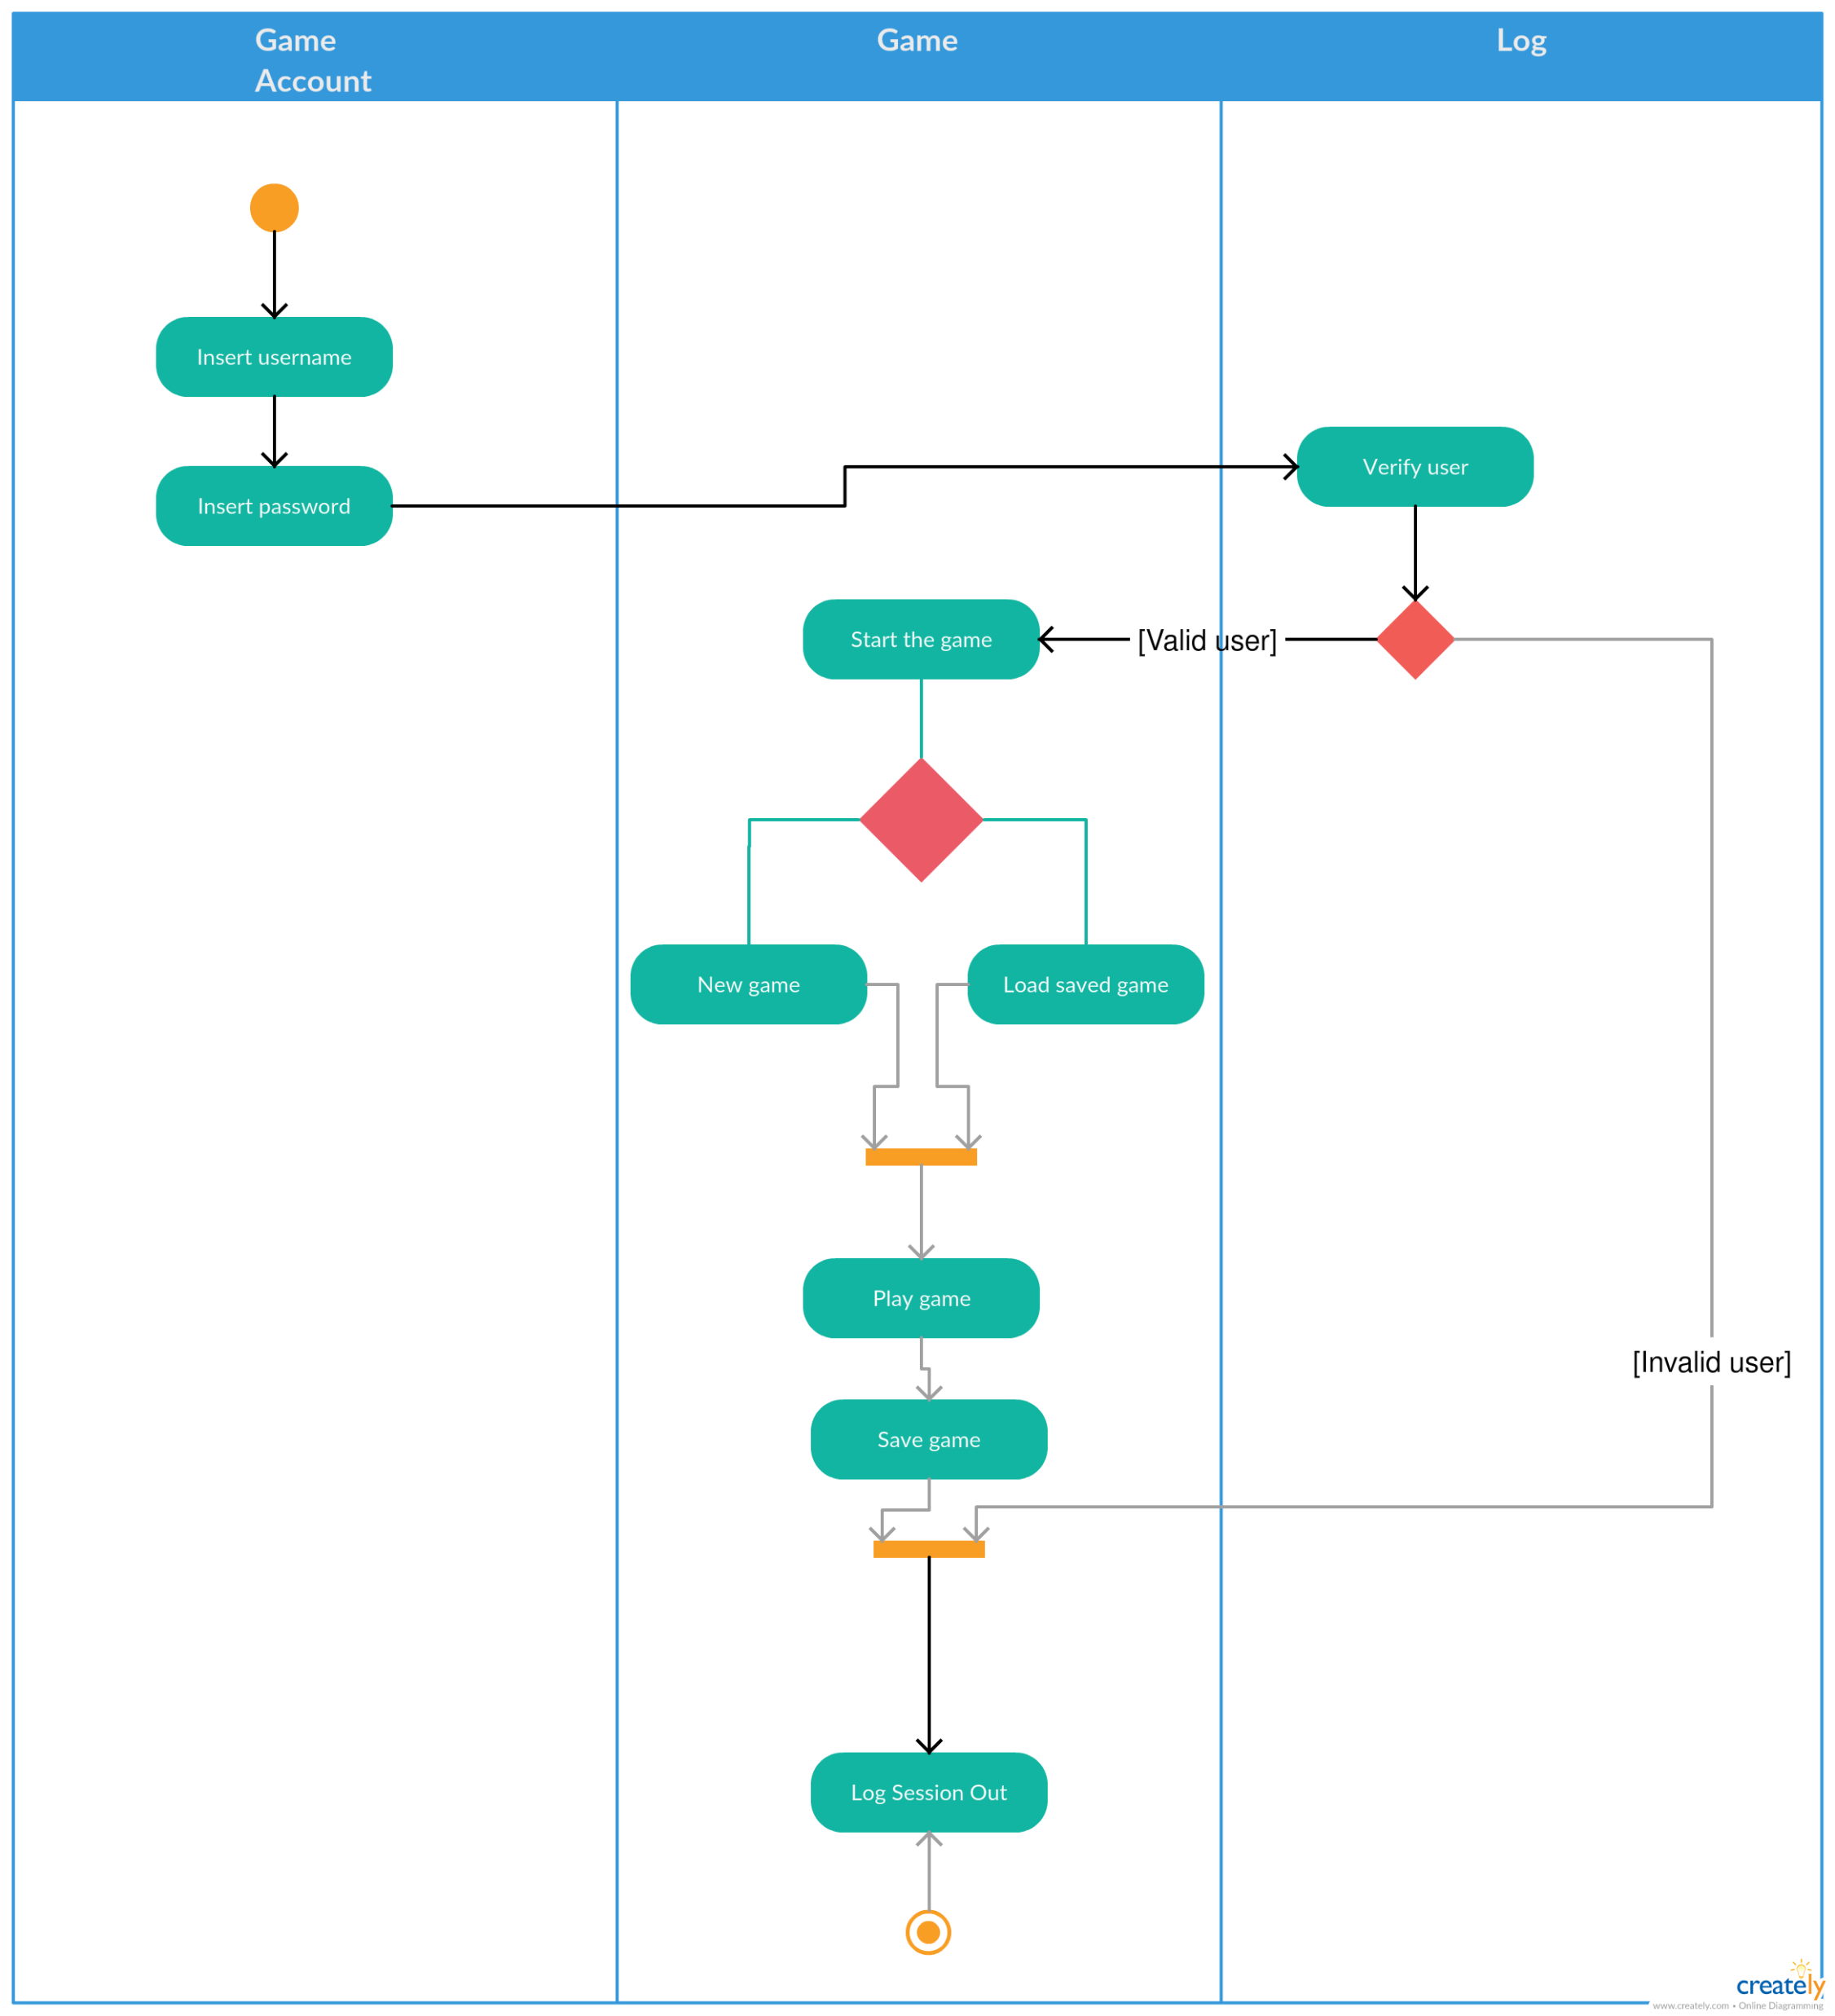
Activity diagram:

Slide 6
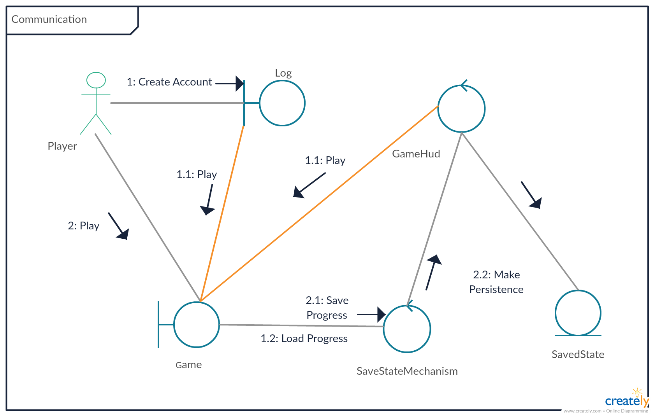
Communication diagram:

Slide 7
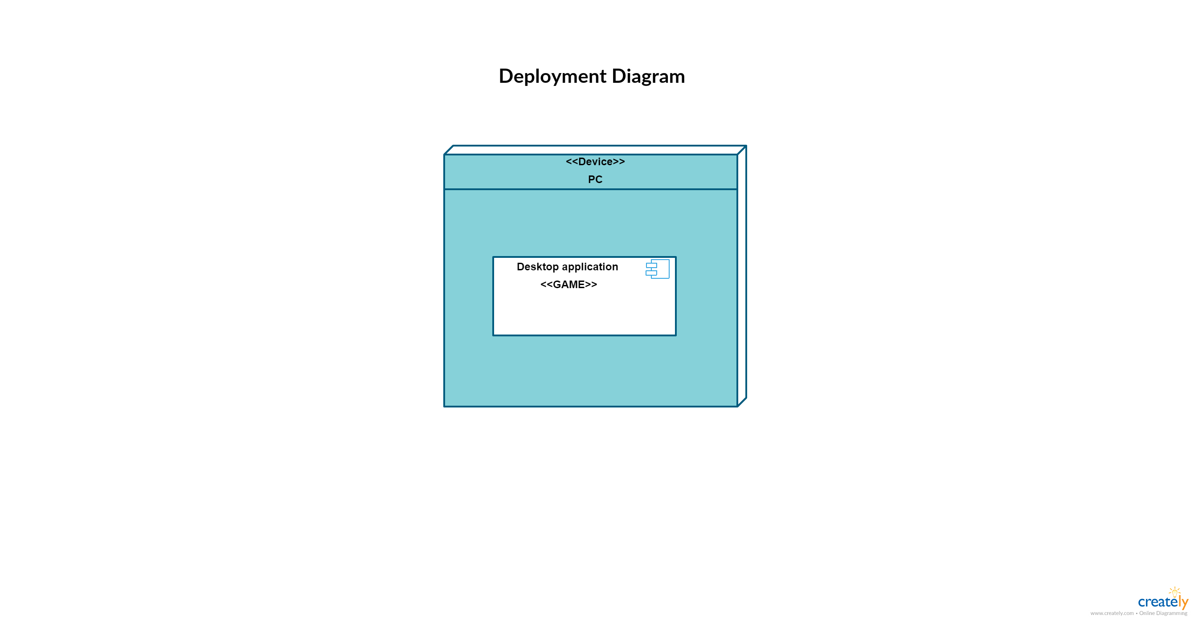
Deployment diagram:

Slide 8
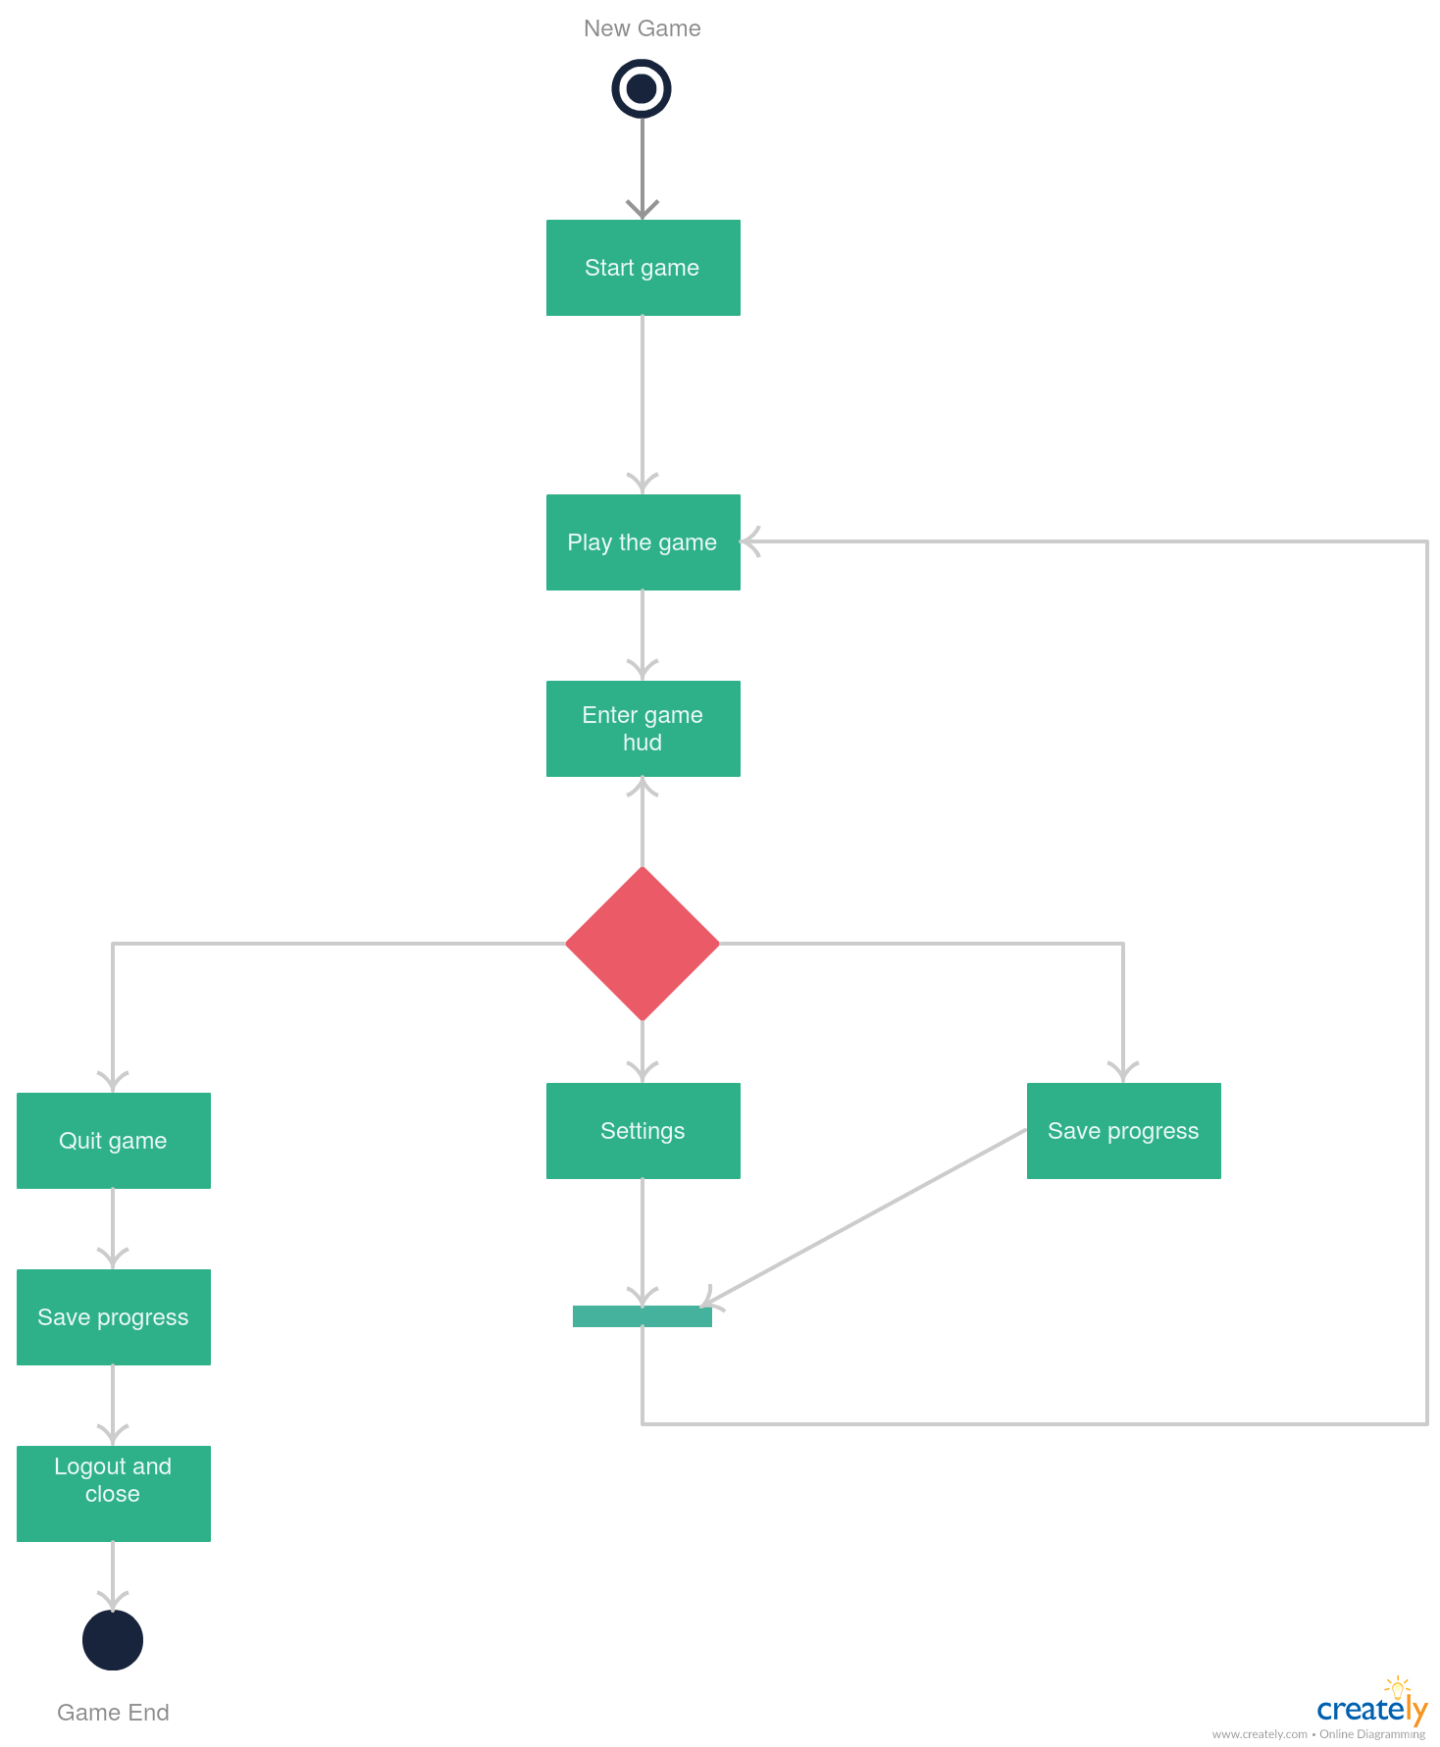
State diagram:

Slide 9
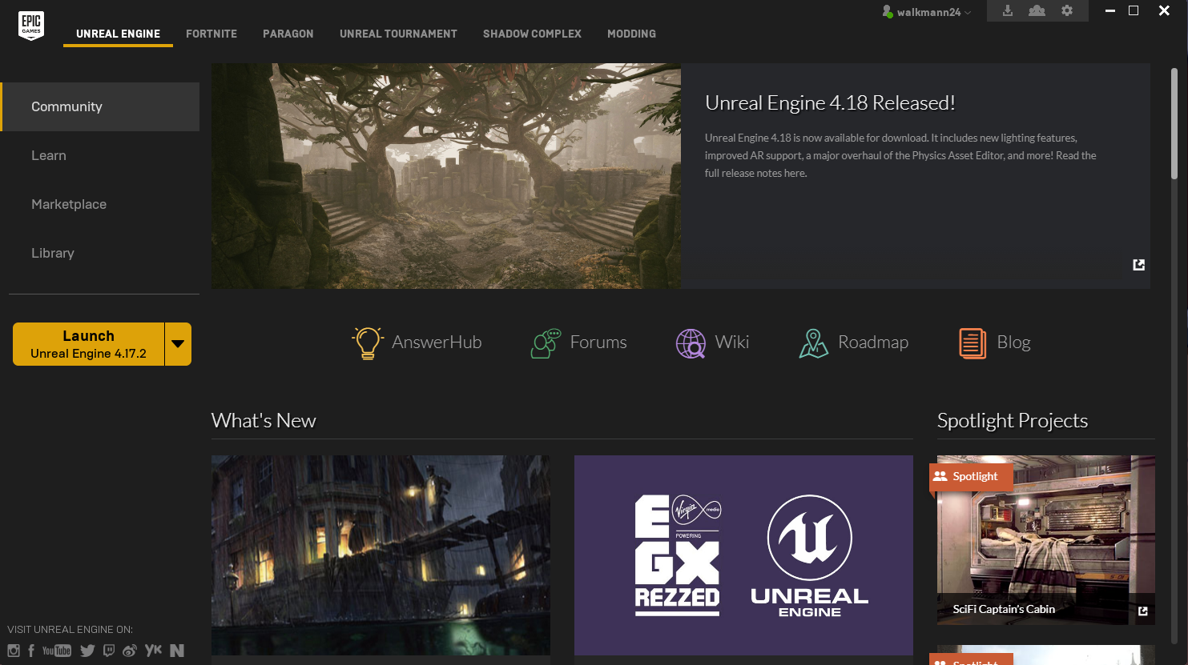
How does the environment look like?

Slide 10
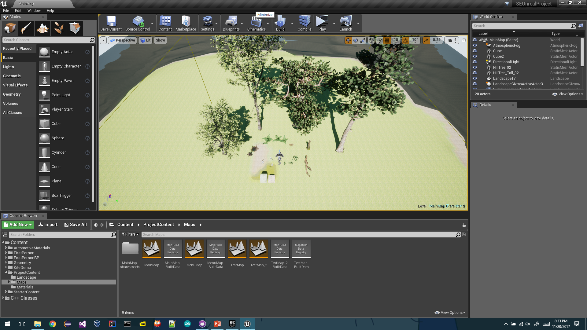

Slide 11
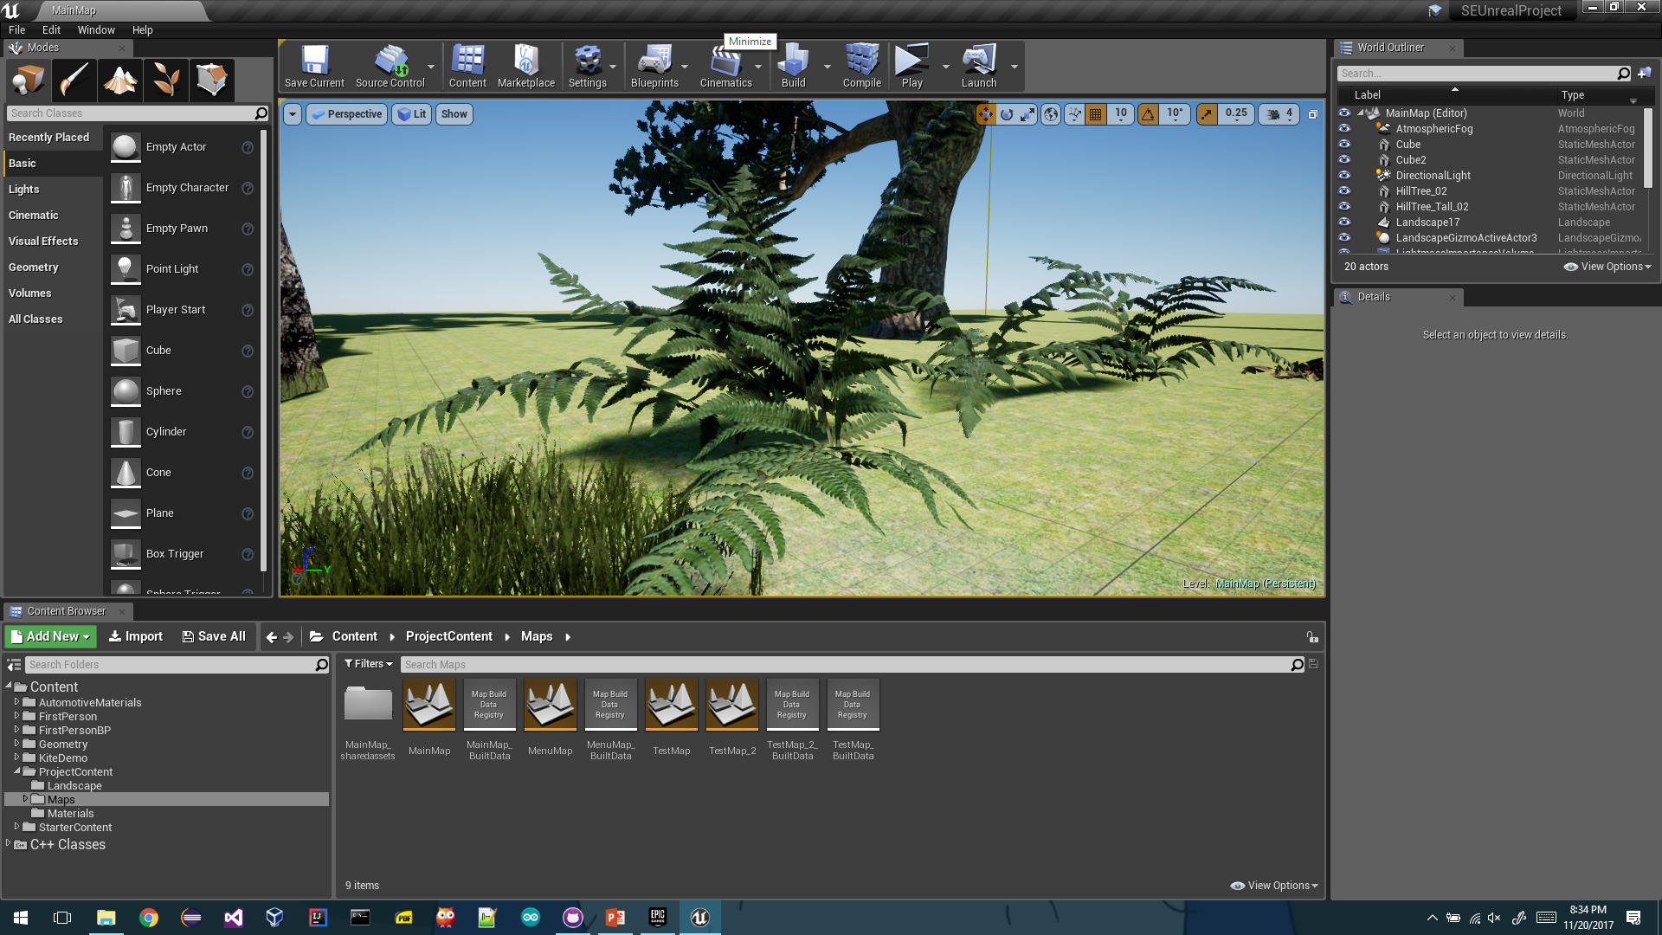

Slide 12
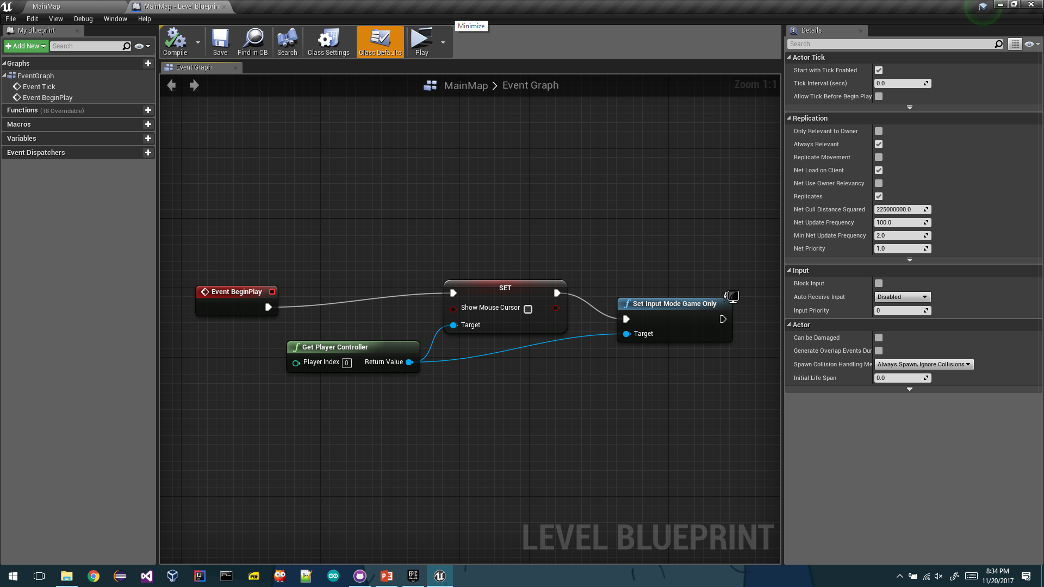

Slide 13
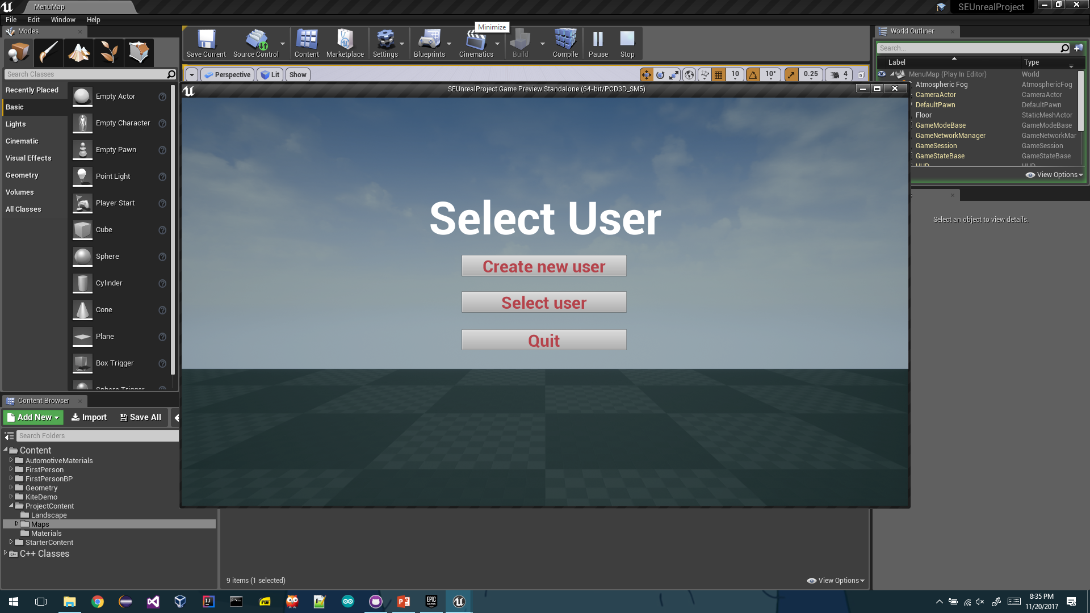

Slide 14
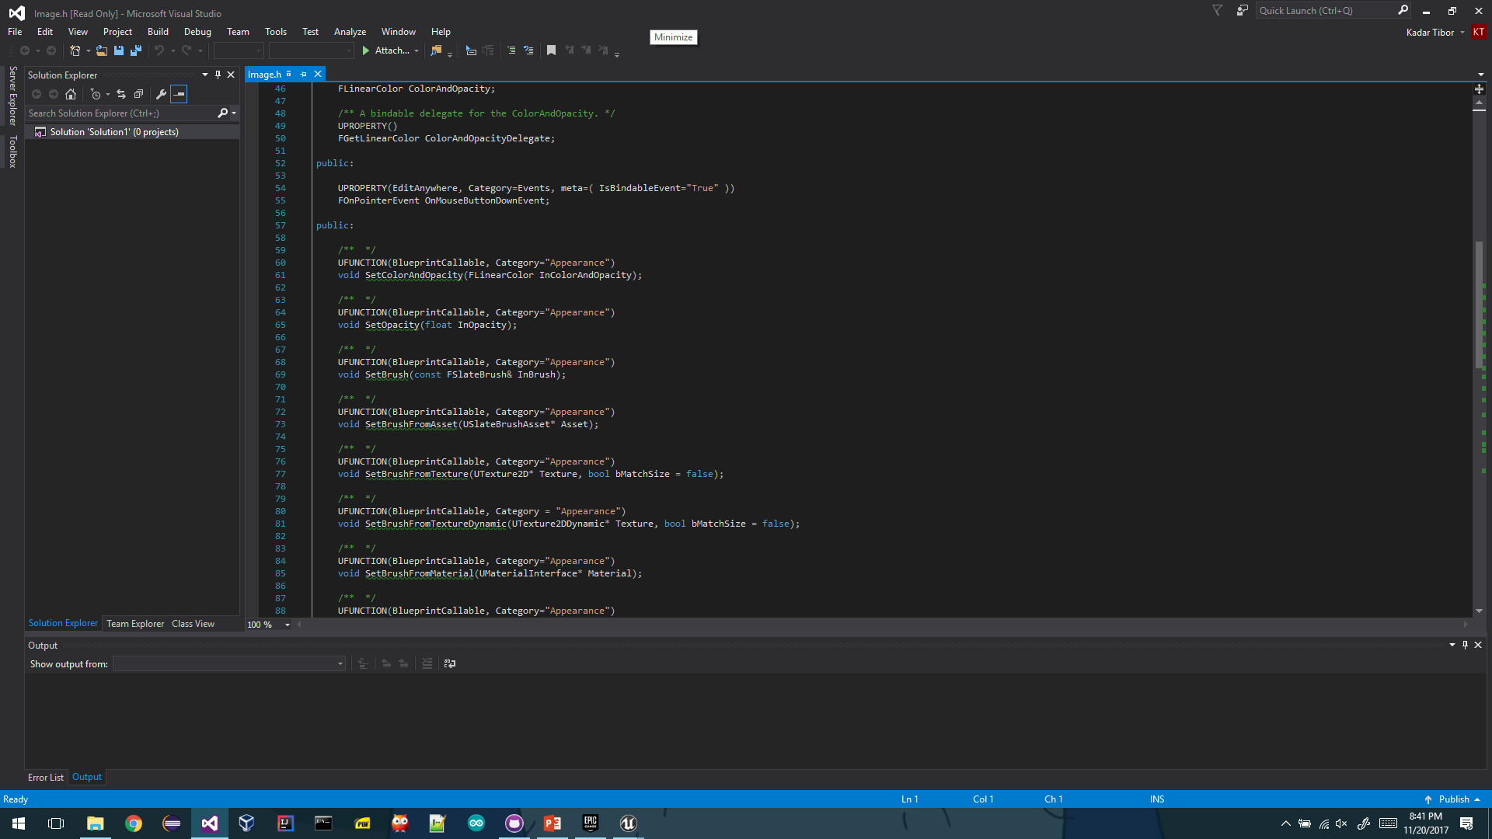

Slide 15
Thank you for your time
Developers:
Zavacki Peter Tibor
Kadar Tibor Manasse

